Slide 1
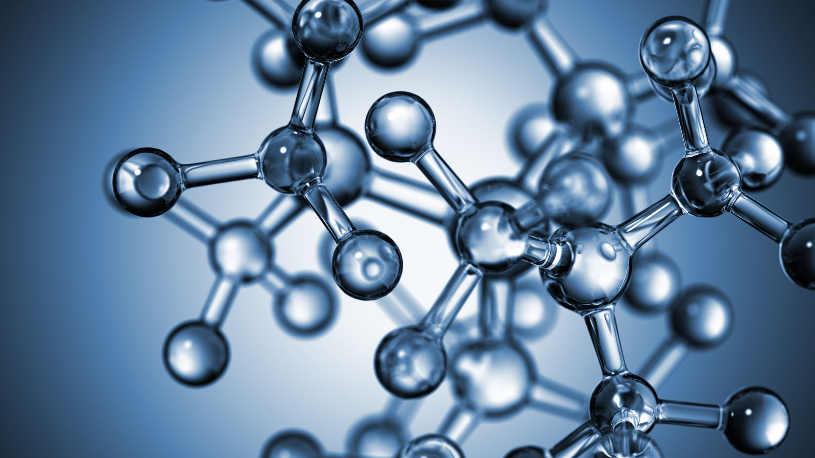


The second principle of thermodynamics. The concept of entropy. The concept of Gibbs energy.
Al-Farabi Kazakh National University
Faculty of Chemistry and Chemical technology
Department of General and Inorganic Chemistry
pHd Bakhadur askar

Slide 2
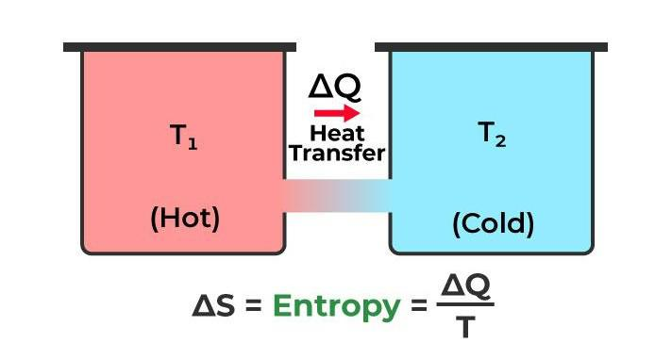
The second law of thermodynamics
The Second Law of Thermodynamics describes the direction of natural processes.
It states that the total entropy of an isolated system can never decrease over time.
This law introduces the concept of irreversibility in nature.
It explains why heat flows spontaneously from hot to cold and not the reverse.
The Second Law defines the arrow of time in physical and chemical processes.

Slide 3
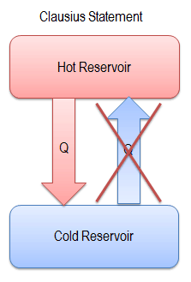
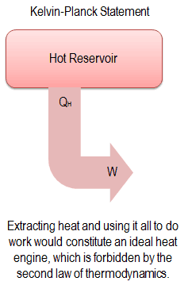
Different statements of the second law
Clausius Statement:
Heat cannot spontaneously flow from a colder body to a hotter body without external work.
Kelvin–Planck Statement:
It is impossible to construct a cyclic engine that converts all absorbed heat into work.
Both statements describe the impossibility of 100% efficiency in real engines.
These are equivalent formulations expressing the same fundamental law.

Slide 4

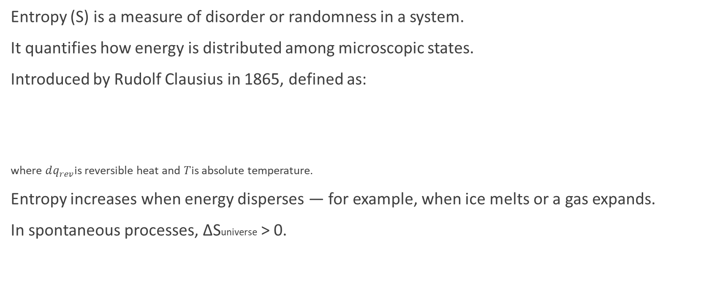
The concept of entropy
Entropy (S) is a measure of disorder or randomness in a system.
It quantifies how energy is distributed among microscopic states.
Introduced by Rudolf Clausius in 1865, defined as:
where $dq_{rev}$is reversible heat and $T$is absolute temperature.
Entropy increases when energy disperses — for example, when ice melts or a gas expands.
In spontaneous processes, ΔSuniverse > 0.
$$dS=\frac{dq_{rev}}{T}$$

Slide 5

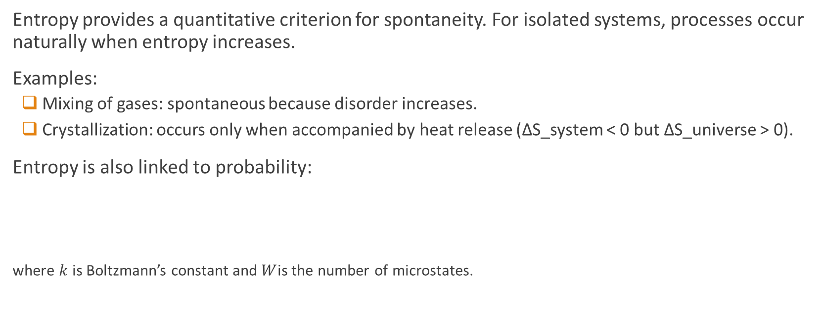
Entropy and the direction of processes
Entropy provides a quantitative criterion for spontaneity. For isolated systems, processes occur naturally when entropy increases.
Examples:
  Mixing of gases: spontaneous because disorder increases.
  Crystallization: occurs only when accompanied by heat release (ΔS_system < 0 but ΔS_universe > 0).
Entropy is also linked to probability:
where $k$is Boltzmann’s constant and $W$is the number of microstates.
$$S=k\ln{W}$$

Slide 6

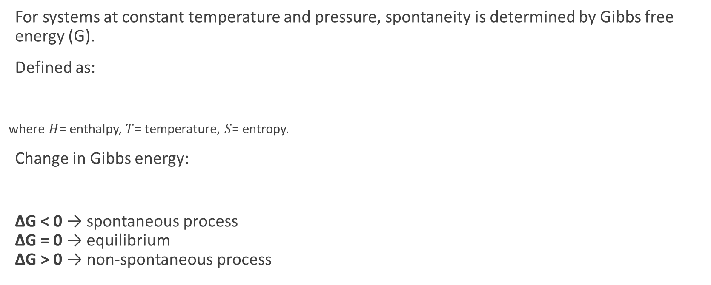

Gibbs free energy
For systems at constant temperature and pressure, spontaneity is determined by Gibbs free energy (G).
Defined as:
where $H$= enthalpy, $T$= temperature, $S$= entropy.
Change in Gibbs energy:
ΔG < 0 → spontaneous process
ΔG = 0 → equilibrium
ΔG > 0 → non-spontaneous process
$$G=H−TS$$
$$ΔG=ΔH−TΔS$$

Slide 7

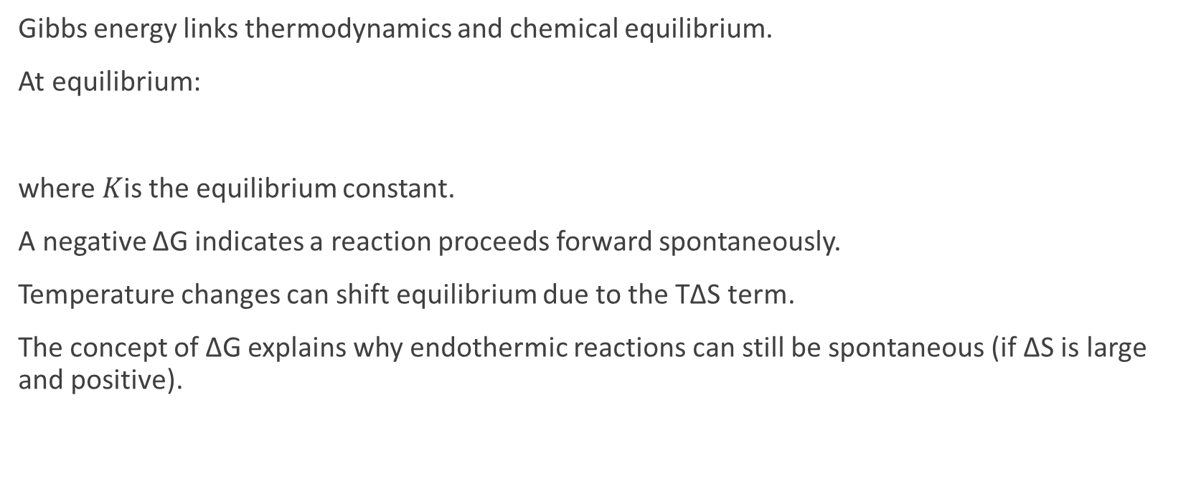
Gibbs Energy and Chemical Reactions
Gibbs energy links thermodynamics and chemical equilibrium.
At equilibrium:
where $K$is the equilibrium constant.
A negative ΔG indicates a reaction proceeds forward spontaneously.
Temperature changes can shift equilibrium due to the TΔS term.
The concept of ΔG explains why endothermic reactions can still be spontaneous (if ΔS is large and positive).
$$ΔG=0 \text{and} ΔG^{∘}=−RT\ln{K}$$

Slide 8
Summary
The Second Law establishes the natural direction of processes — towards increased entropy.
Entropy measures energy dispersion and system disorder.
Gibbs free energy combines enthalpy and entropy effects to predict spontaneity.
These concepts are foundational in:
  Thermodynamics
  Chemical equilibrium
  Energy conversion technologies
Understanding them allows scientists to predict and control chemical and physical transformations.

Slide 9

Questions?

